Slide 1
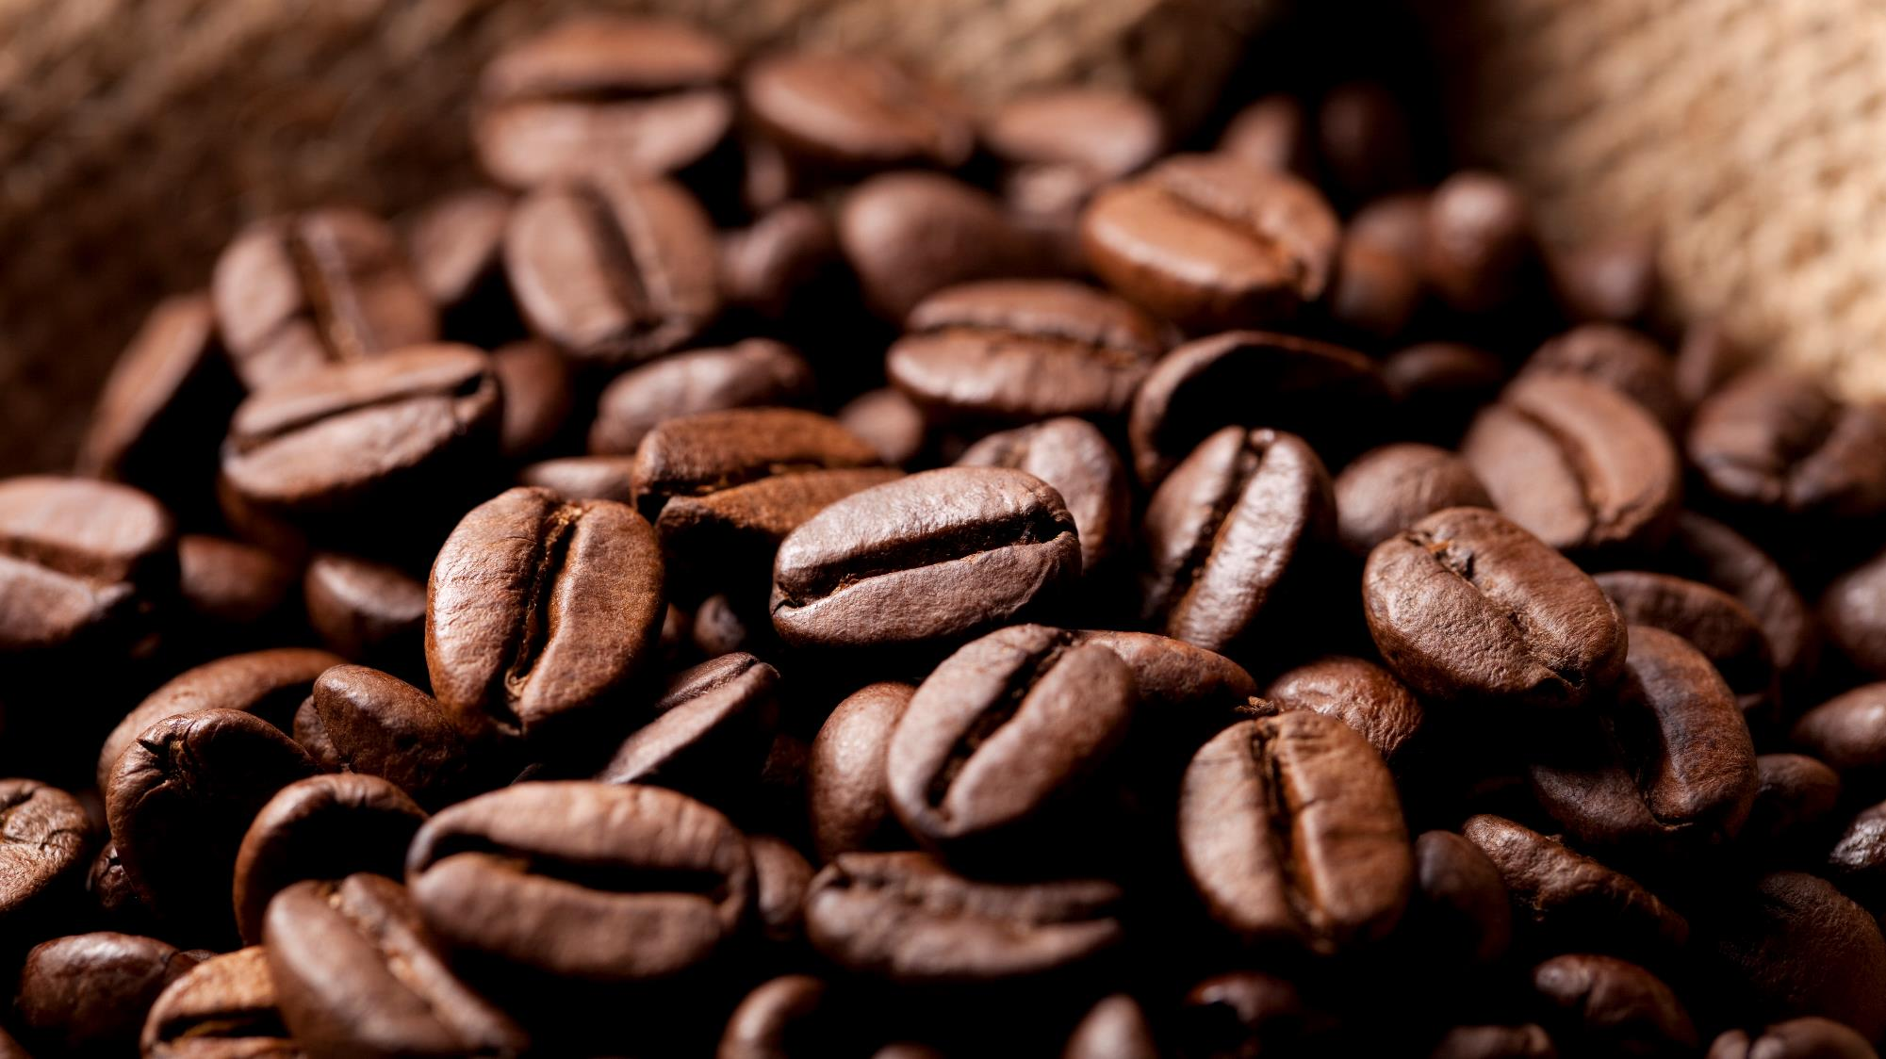
dBF COFFEE SHOP
DEVELOPED BY :
M.DHANI SETIAWAN
KAPTEN BINTANG
FERDIANSYAH

Slide 2


BACKGROUND
To make a simple application for selling coffee

Slide 3


Schema
Opening App
Coffee shop menu
coffee detail Menu
custumer Menu
Transaction menu

Slide 4

DBF Coffee shop application display

Slide 5
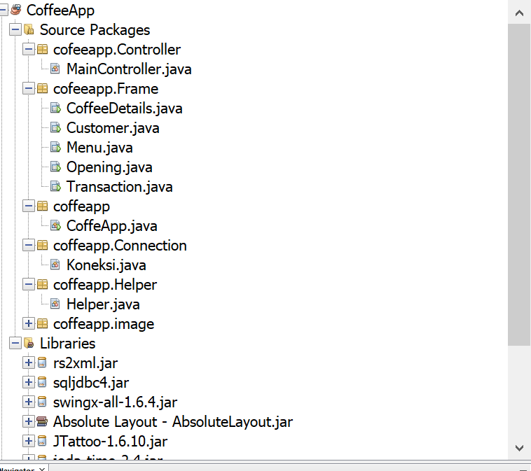
Our Source Package

Slide 6
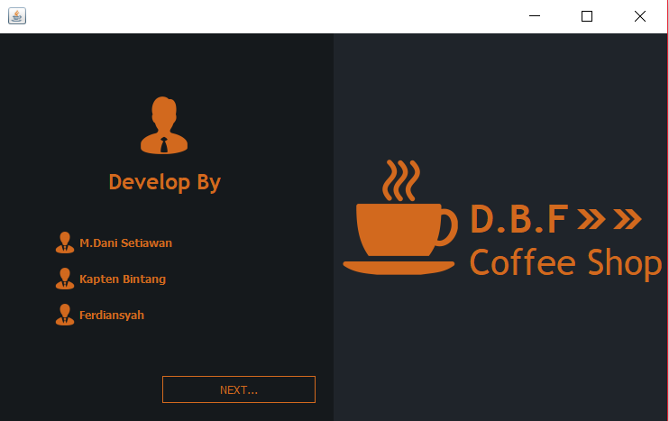
Opening App

Slide 8
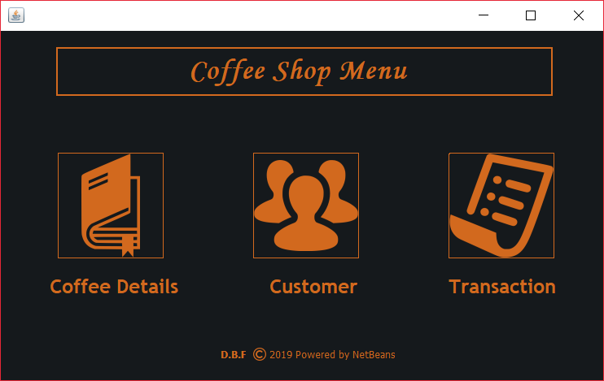
Menu

Slide 9
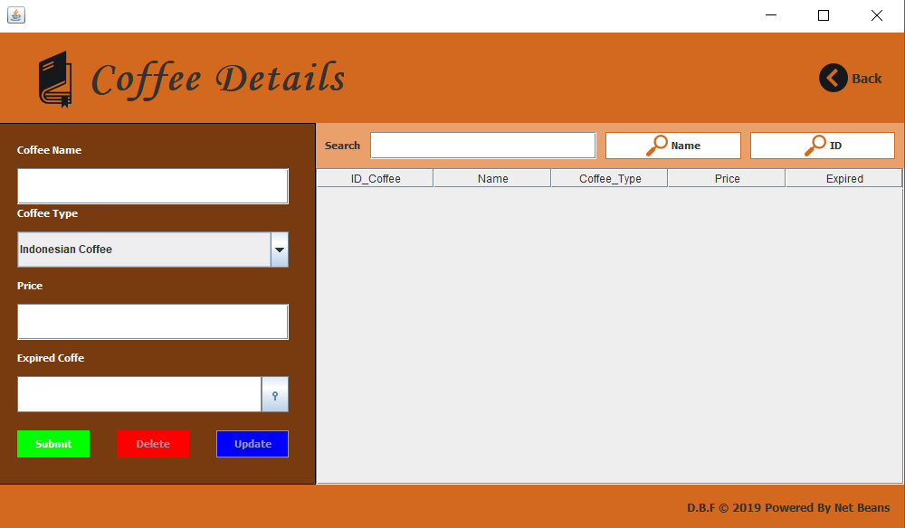
Menu Coffee detailed

Slide 10
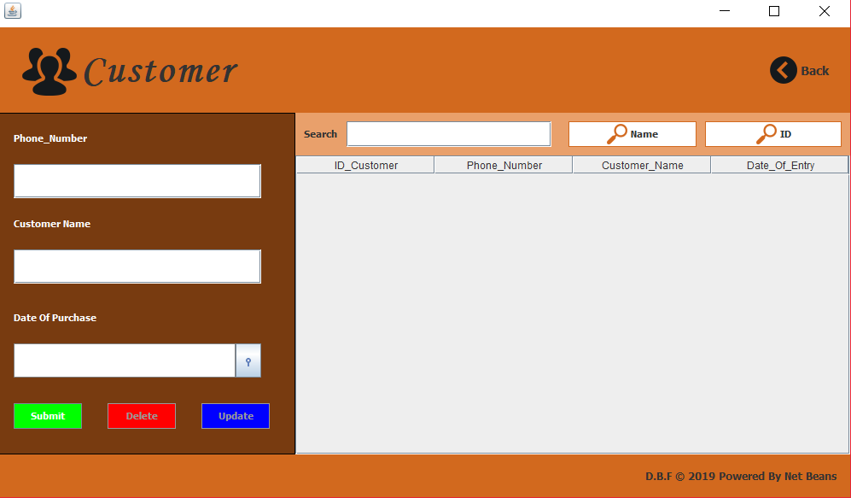
Menu Customer

Slide 11
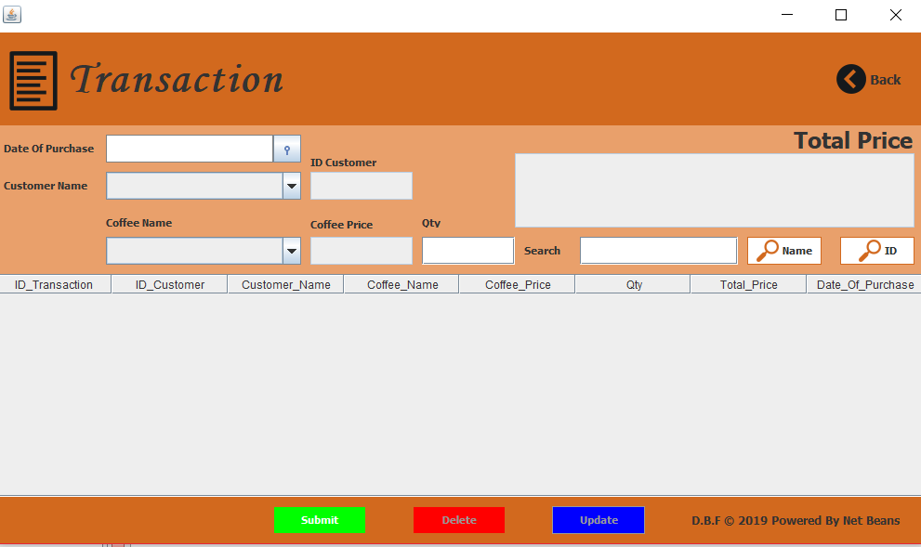
Transaction

Slide 12
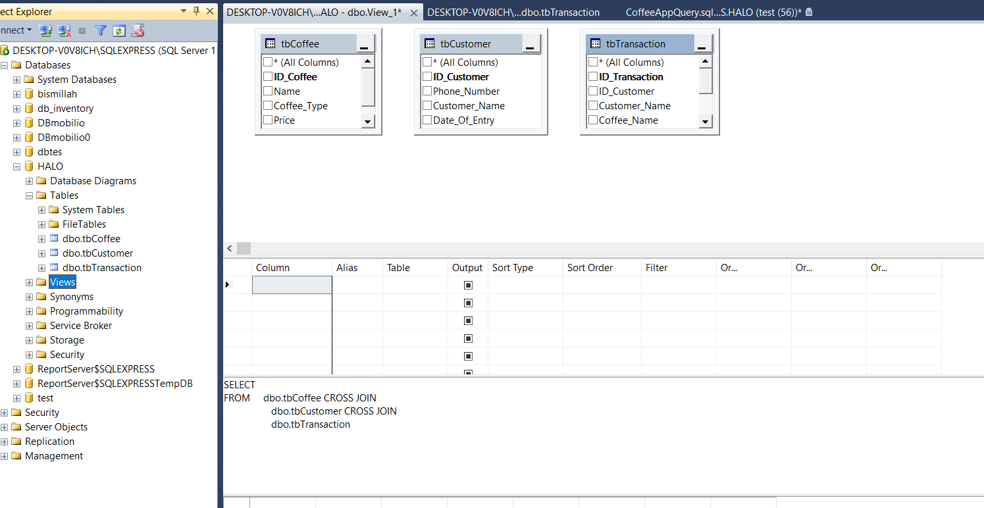
In the SQL View

Slide 13


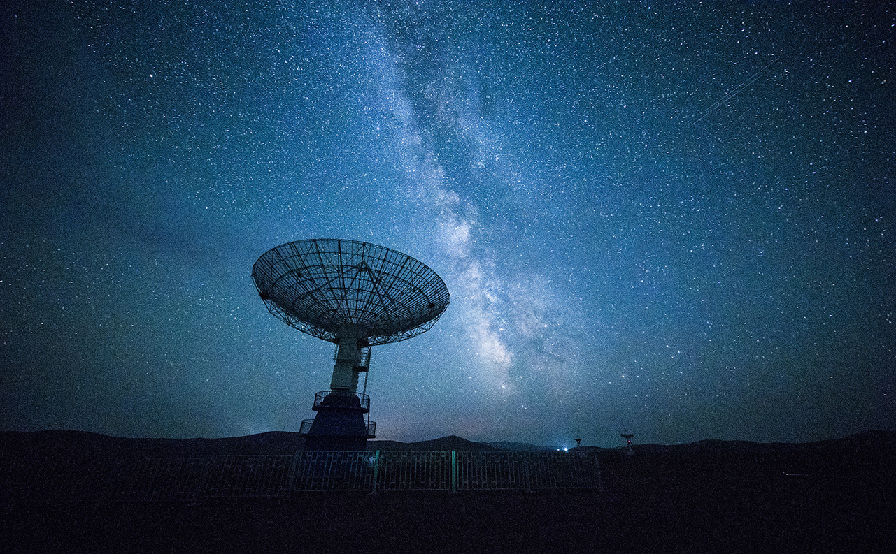
configuration
compatible with an Intel Core – i5 processor, 8 GB RAM and 128 GB of SSD (tested)
Microsoft sql server 2014
Microsoft Windows 10
Netbeans IDE 8.2

Slide 14
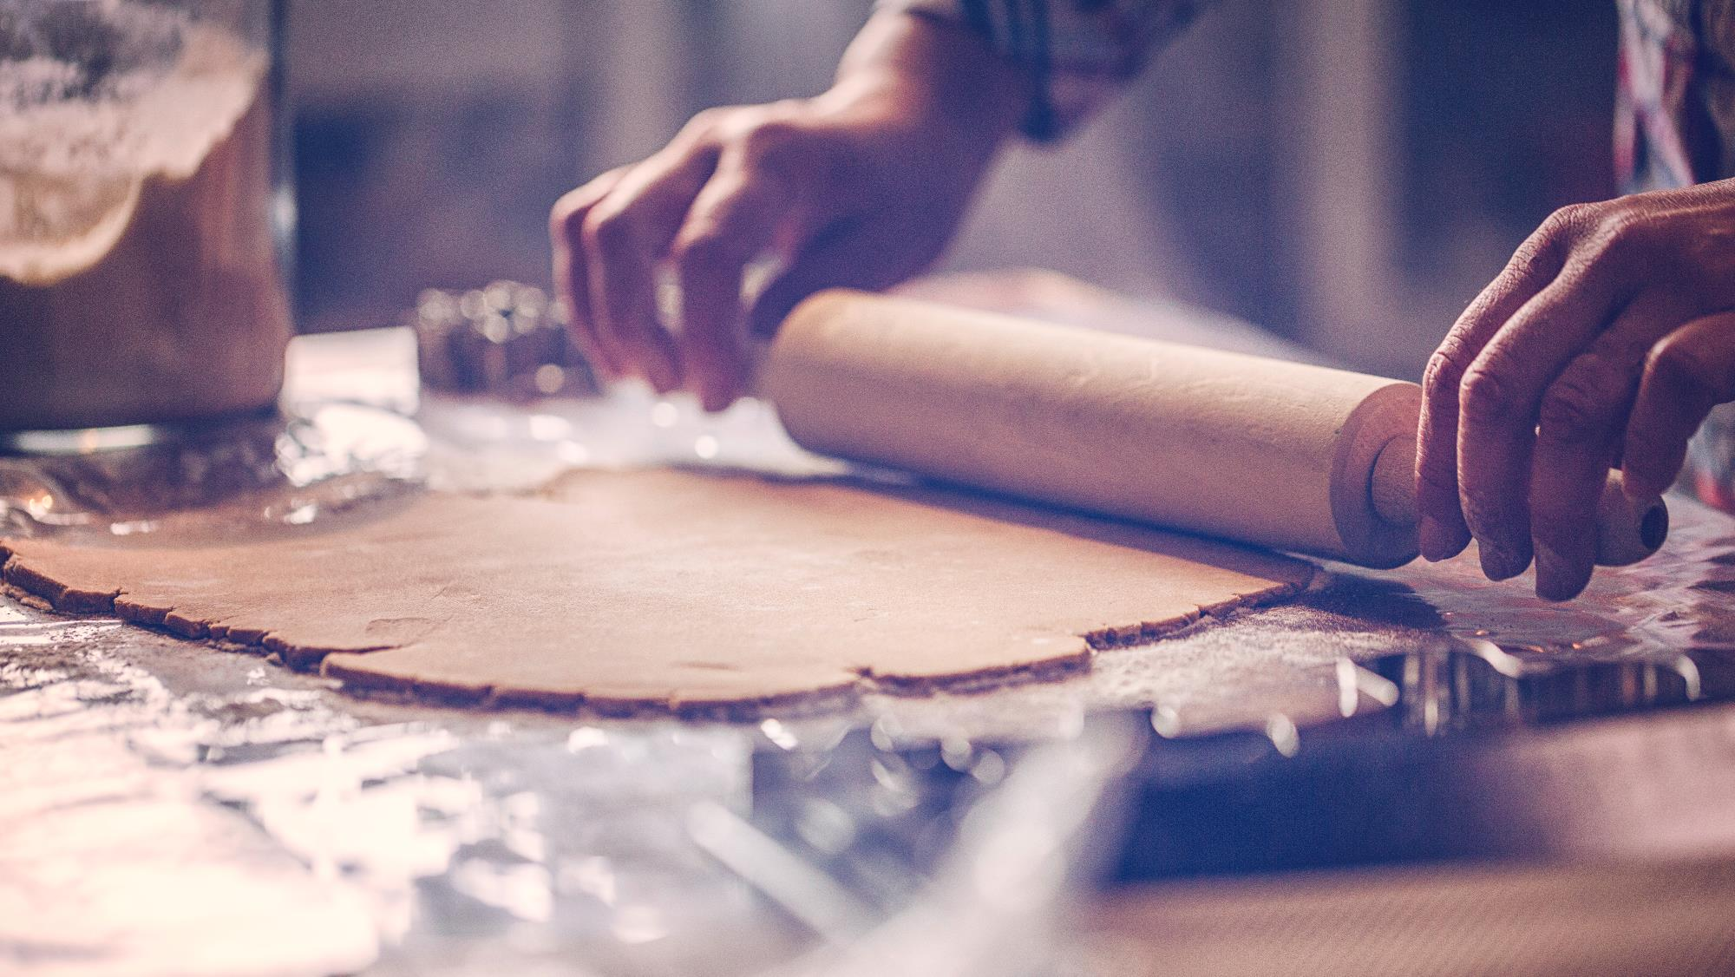

The advantages
Good
Display
Connected with sql
the work of the Indonesian people

Slide 15
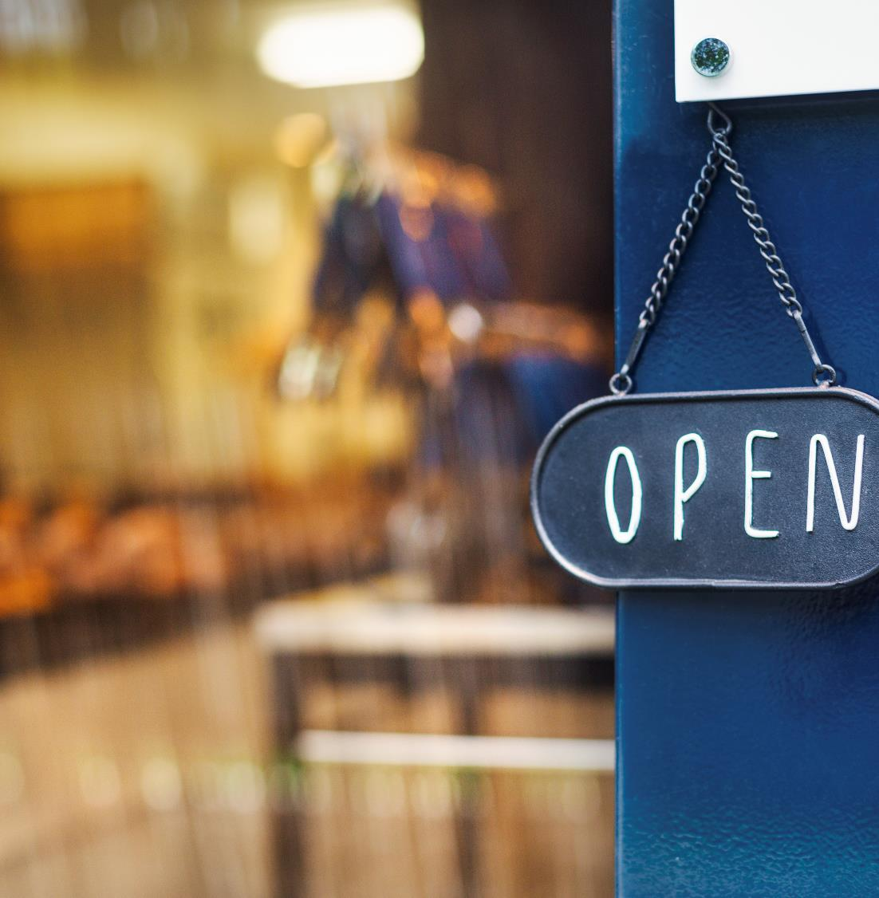
Thank You
Any question

Slide 16
BFD COFFEE APP
Consumer
Competitor
Market

